Slide 1
One-way ANOVA
STAT XX YY

Slide 2
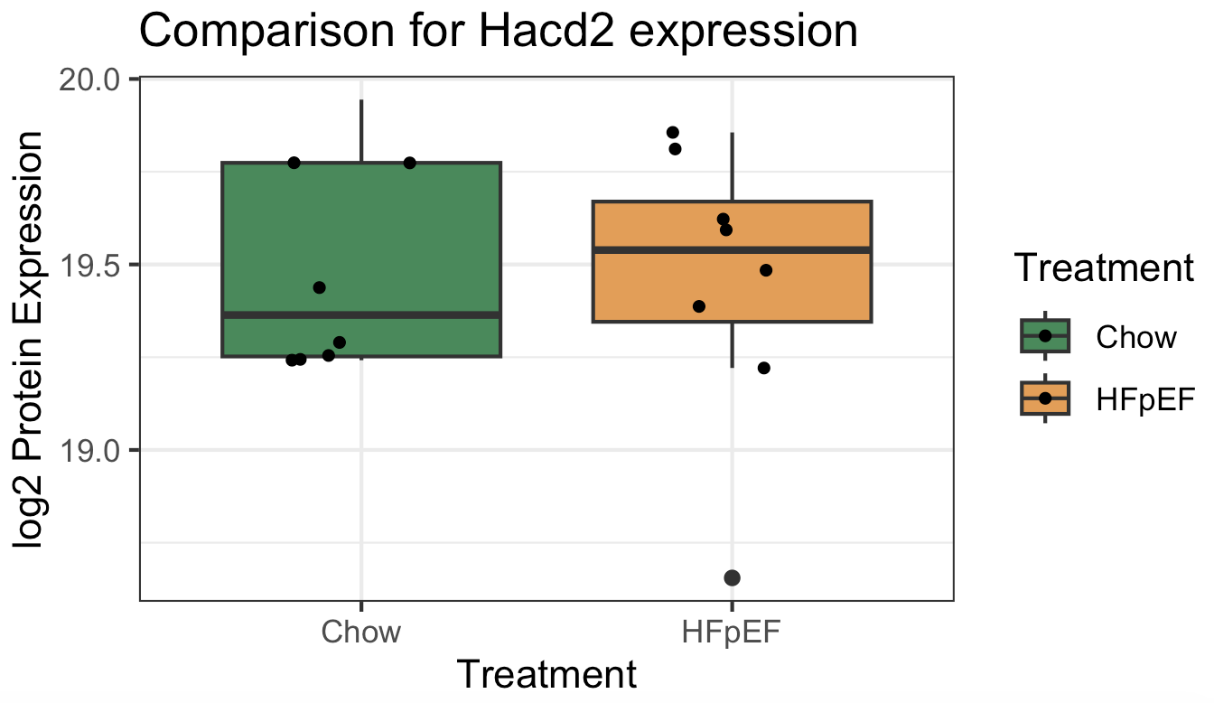
Two-sample t-test
Laboratory mice diet study for heart failure
8 mice on Chow diet (control), 8 mice have HFpEF (heart failure)
Goal: mean protein expression differences in two groups
Notes:
Graph on the left, two columns

Slide 3
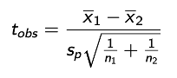
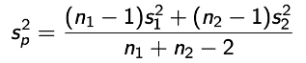
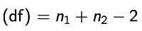
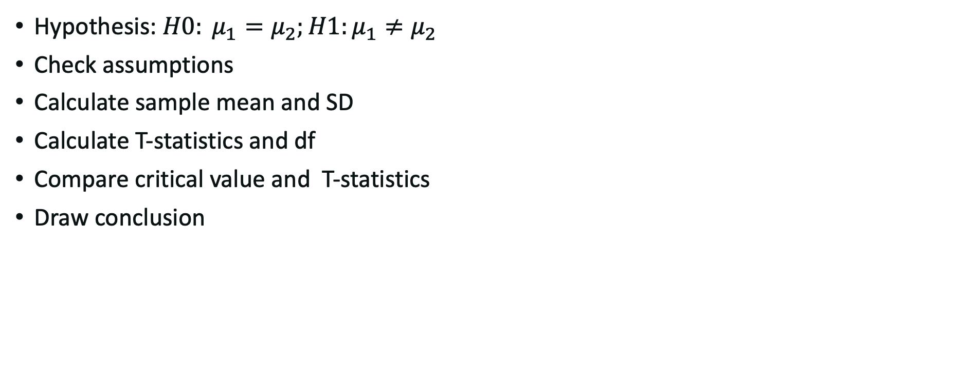
Two-sample t-test
Hypothesis: $H0: μ_{1}=μ_{2};H1:μ_{1}≠μ_{2}$
Check assumptions
Calculate sample mean and SD
Calculate T-statistics and df
Compare critical value and T-statistics
Draw conclusion

Slide 4
What if we develop a treatment for heart failure?

Slide 5
Three groups comparison
Laboratory mice diet study for heart failure
8 mice on Chow diet (control), 8 mice have HFpEF (heart failure), 8 mice with NR prevention (Nicotinamide Ribosid treatment)
Goal: mean protein expression differences in three groups

Slide 6
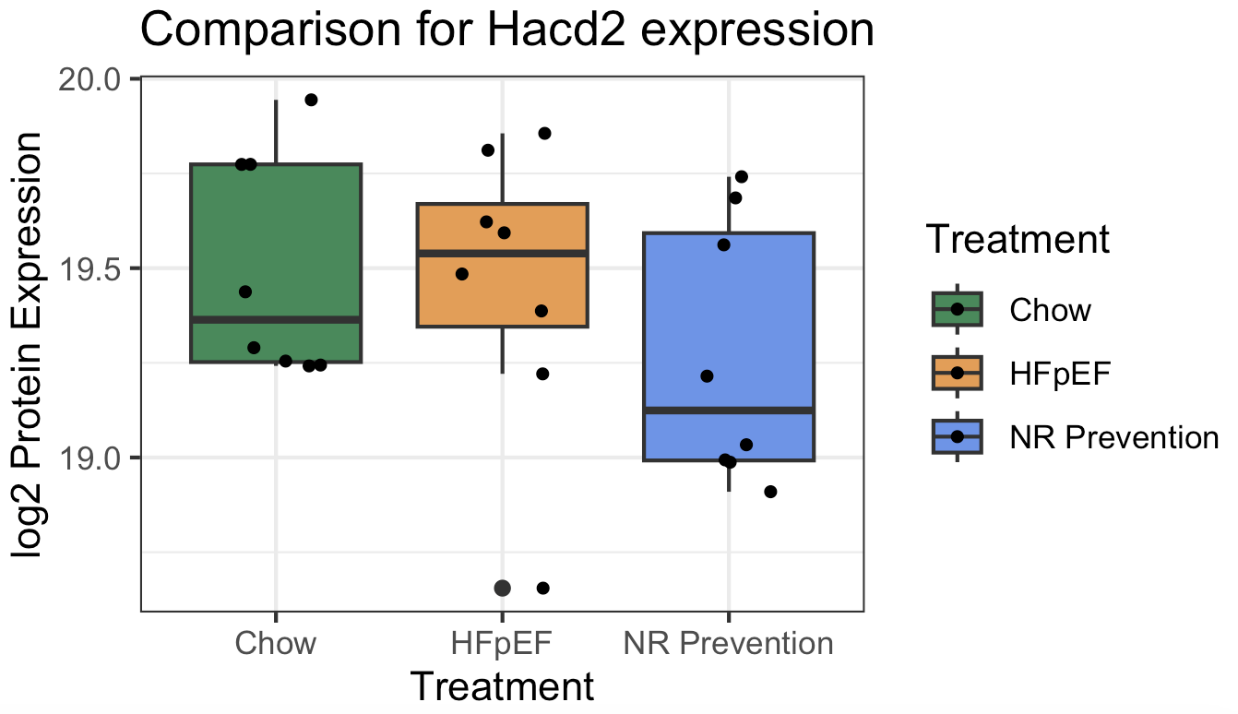
Three groups comparison
Laboratory mice diet study for heart failure
8 mice on Chow diet (control), 8 mice have HFpEF (heart failure), 8 mice with NR prevention (Nicotinamide Ribosid treatment)
Goal: mean protein expression differences in three groups

Slide 7
Can we compare the difference in a more formal way?
Can we perform pairwise comparisons? (covered in next lecture)
Can we look at the variation within one group as well?
🤔
🤔
🤔

Slide 8
One-way ANOVA
Analysis of Variance (ANOVA) is what we are looking for!

Slide 9
One-way ANOVA
Analysis of Variance (ANOVA) is what we are looking for!
Conceptually: Compare the variation for the means
Total variation= Between group variation + Among group variation

Slide 10
One-way ANOVA
Analysis of Variance (ANOVA) is what we are looking for!
Conceptually: Compare the variation for the means
Total variation= Between group variation + Among group variation
We quantify this into the variance decomposition (more math later):
Total sum of squares= Between group sum of squares + Within group sum of squares
Notes:
Be careful: it is about comparing the means, the variance of the mean,

Slide 11
Perform the test
What is H0?
Check H0 for t-test

Slide 12
Perform the test
What is H0?
What is the test statistics?
Check H0 for t-test
Trick:
the distribution of the ratio of the mean square treatment (between group, red) to the mean square residual (within group, blue) follows a F-distribution (F(g-1, N-g)) under the null hypothesis.
Total sum of squares= Between group sum of squares + Within group sum of squares
g is the number of groups, N is the total number of individuals

Slide 13
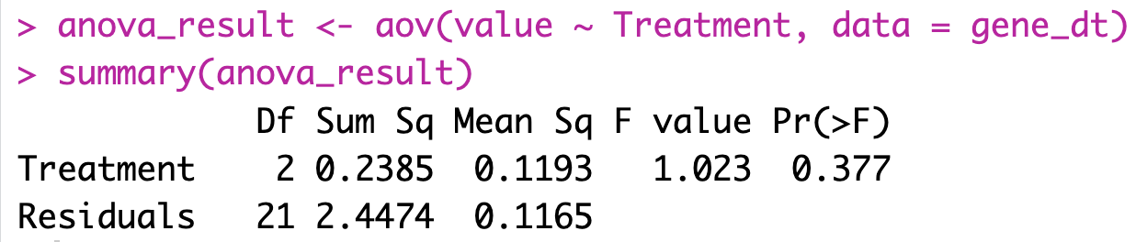
Your turn
Given the R output (you will see how to code later):
Hypothesis:
Calculation:
Test statistics:
Compare critical value and test statistics:
Draw conclusion: reject/do not reject H0 because
Notes:
Check the p values for pariwise comparisons.

Slide 14
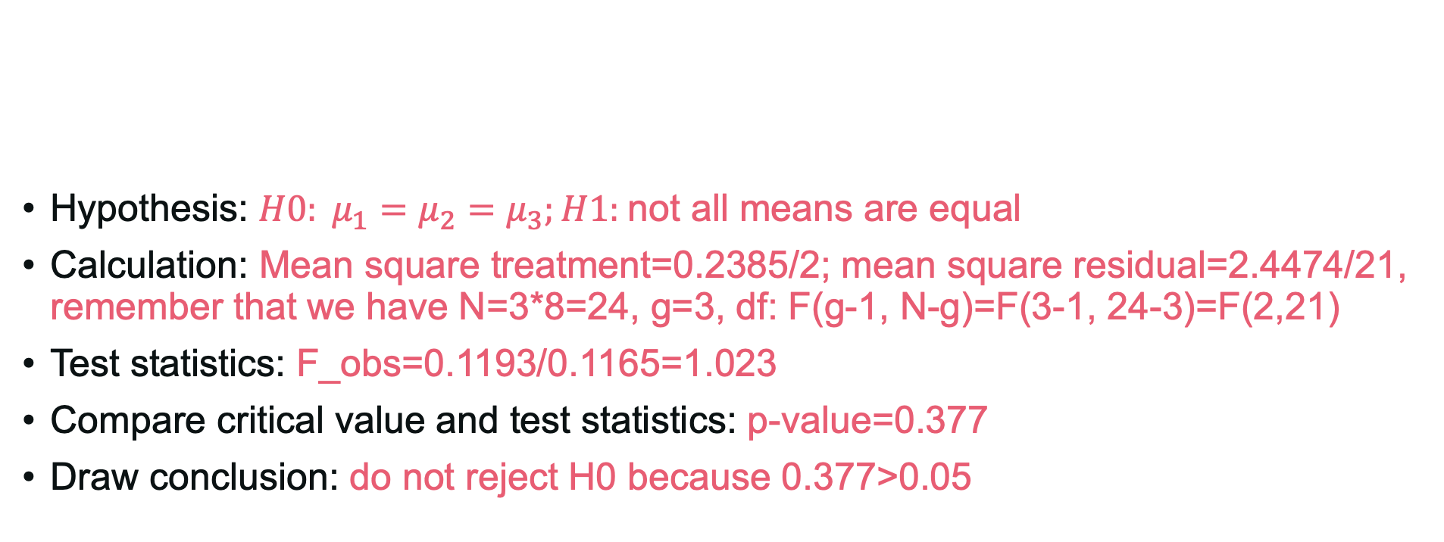
Your turn
Hypothesis: $H0: μ_{1}=μ_{2}=μ_{3};H1:$not all means are equal
Calculation: Mean square treatment=0.2385/2; mean square residual=2.4474/21, remember that we have N=3*8=24, g=3, df: F(g-1, N-g)=F(3-1, 24-3)=F(2,21)
Test statistics: F_obs=0.1193/0.1165=1.023
Compare critical value and test statistics: p-value=0.377
Draw conclusion: do not reject H0 because 0.377>0.05

